Slide 2
DQN Overview
Off Policy learning algorithm
Uses a Neural Network to approximate the quality of a state, action tuple
Optimal action is then to select the action with the highest expected quality.

Slide 3
DQN Hyperparameters
Action Space Dimensions
Network Size
Learning Rate
Epoch
Batch Size
L2 Regularization
Activation
Retrain Frequency
Epsilon Range & Anneal
Reward Discount Factor

Slide 4
DQN Performance
Single Step, Single Asset Merton

Slide 5
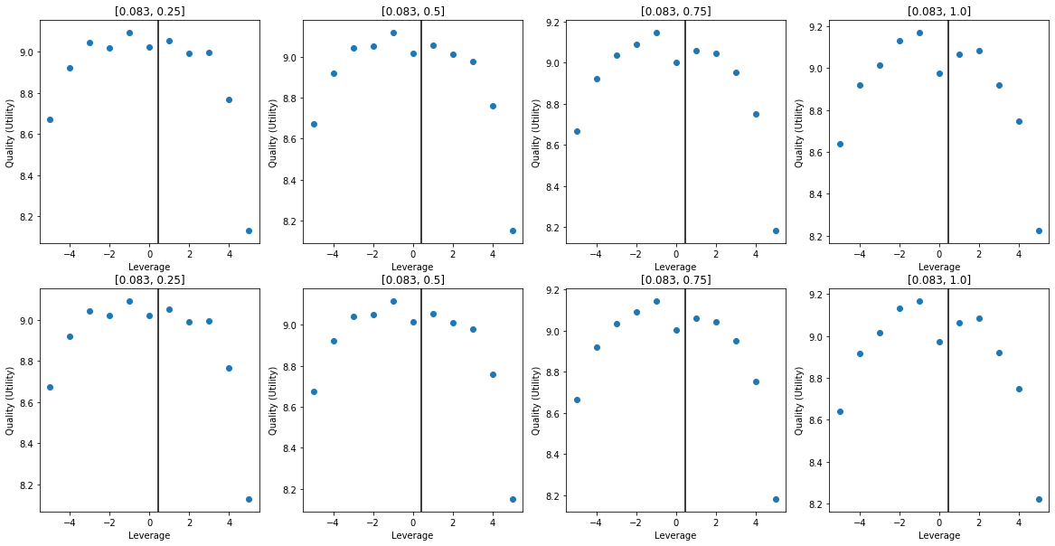
Trial I
# DQN Hyperparameters
"Learning Rate”. : 0.0008
"Epoch" : 1
"Network Size" : [150, 8, 8]
"Activation" : "Sigmoid"
"Alpha" : 0.0
"Batch Size" : 256
"Action Dim" : 11
"Retrain Frequency" : 1 # Episode(s)
"Gamma" : 0.9992
# Environment Settings
”Mu" : 0.06
"Sigma" : 0.35
"Risk Free" : 0.01
"Max/Min Leverage" : +-5
"Time Horizon" : 1/12
"Time Step" : 1/12
"Risk Aversion" : 0.9
"Number Eps" : int(1e4)
Notes:
We begin with the settings which proved viable in previous investigations.
The solution has the correct form, however the effect of starting wealth has been underappreciated, and there is a high degree of noise.

Slide 6
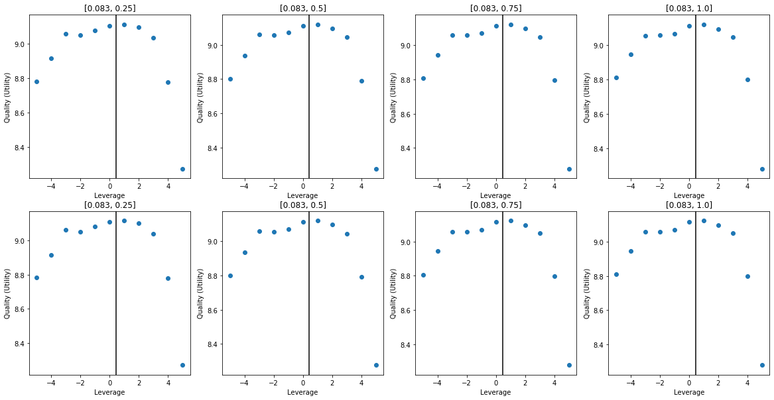
Trial II
# DQN Hyperparameters
"Learning Rate”. : 0.0008
"Epoch" : 1
"Network Size" : [150, 8, 8]
"Activation" : "Sigmoid"
"Alpha" : 0.1
"Batch Size" : 256
"Action Dim" : 11
"Retrain Frequency" : 1 # Episode(s)
"Gamma" : 0.9992
# Environment Settings
”Mu" : 0.06
"Sigma" : 0.35
"Risk Free" : 0.01
"Max/Min Leverage" : +-5
"Time Horizon" : 1/12
"Time Step" : 1/12
"Risk Aversion" : 0.9
"Number Eps" : int(1e4)
Notes:
The introduction of L2 Regularization has decreased the noise of the prediction, however it has also dampened the effect of wealth on quality. In the multi-step setting this will have severe consequences as there is no intermediate reward the agent would be unable to appreciate the boon of increasing ones wealth.

Slide 7
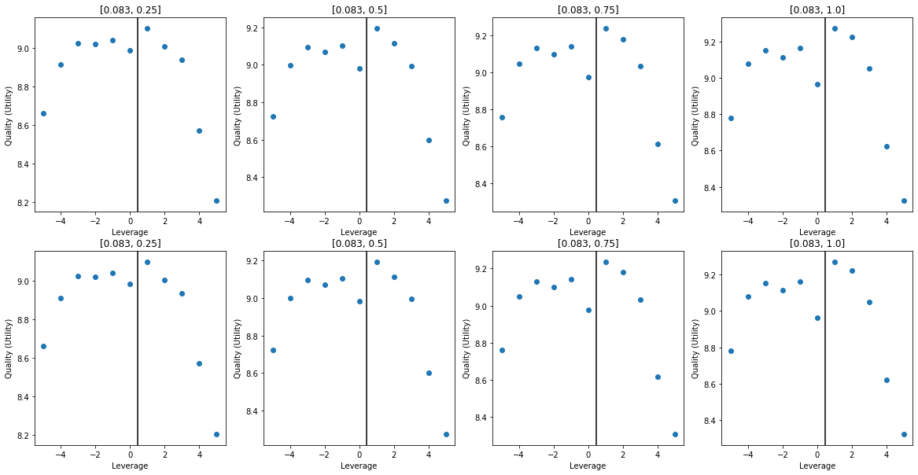
Trial III
# DQN Hyperparameters
"Learning Rate”. : 0.0008
"Epoch" : 1
"Network Size" : [21, 21, 21]
"Activation" : "Sigmoid"
"Alpha" : 0.1
"Batch Size" : 256
"Action Dim" : 11
"Retrain Frequency" : 1 # Episode(s)
"Gamma" : 0.9992
# Environment Settings
”Mu" : 0.06
"Sigma" : 0.35
"Risk Free" : 0.01
"Max/Min Leverage" : +-5
"Time Horizon" : 1/12
"Time Step" : 1/12
"Risk Aversion" : 0.9
"Number Eps" : int(1e4)
Notes:
Here we have altered the network size to investigate performance without the large first layer which was used previously.
So far there are no issues with this, although the multi-step problem will pose a greater challenge.

Slide 8
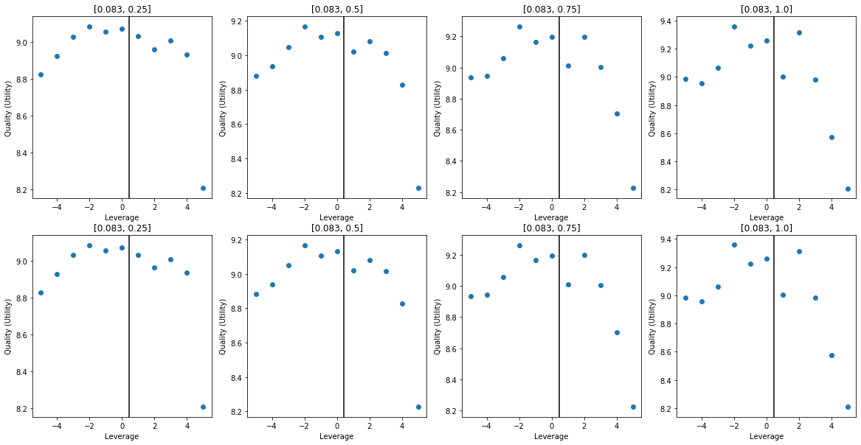
Trial IV
# DQN Hyperparameters
"Learning Rate”. : 0.0008
"Epoch" : 1
"Network Size" : [21, 21, 21]
"Activation" : "Sigmoid"
"Alpha" : 0.0
"Batch Size" : 256
"Action Dim" : 11
"Retrain Frequency" : 1 # Episode(s)
"Gamma" : 0.9992
# Environment Settings
”Mu" : 0.06
"Sigma" : 0.35
"Risk Free" : 0.01
"Max/Min Leverage" : +-5
"Time Horizon" : 1/12
"Time Step" : 1/12
"Risk Aversion" : 0.9
"Number Eps" : int(1e4)
Notes:
By reducing the Alpha (L2 Regularization) term to zero the networks ability to appreciate the dependency of quality on starting wealth has been improved, at the cost of consistency across the action space.

Slide 9
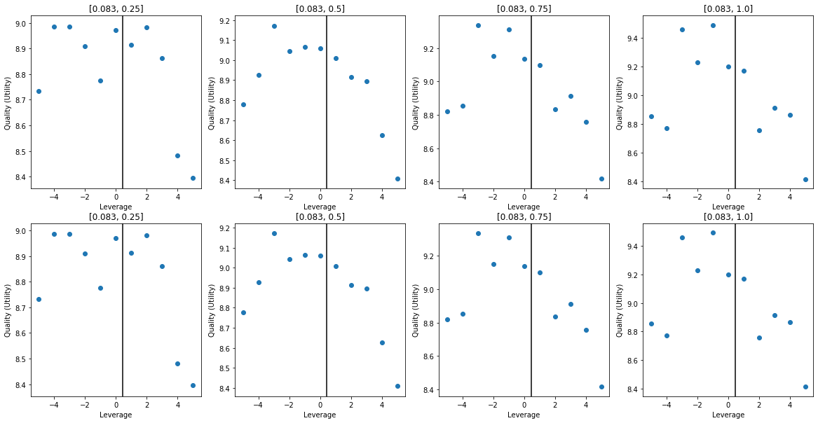
Trial V
# DQN Hyperparameters
"Learning Rate”. : 0.0008
"Epoch" : 1
"Network Size" : [21, 21, 21]
"Activation" : "Sigmoid"
"Alpha" : 0.0
"Batch Size" : 1024
"Action Dim" : 11
"Retrain Frequency" : 1 # Episode(s)
"Gamma" : 0.9992
# Environment Settings
”Mu" : 0.06
"Sigma" : 0.35
"Risk Free" : 0.01
"Max/Min Leverage" : +-5
"Time Horizon" : 1/12
"Time Step" : 1/12
"Risk Aversion" : 0.9
"Number Eps" : int(1e4)
Notes:
Increasing batch size did not have the desired effect of smoothing predictions, but instead seems to have increased the magnitude of noise in the predictions.
Runtime also scales linearly with batch size.

Slide 10
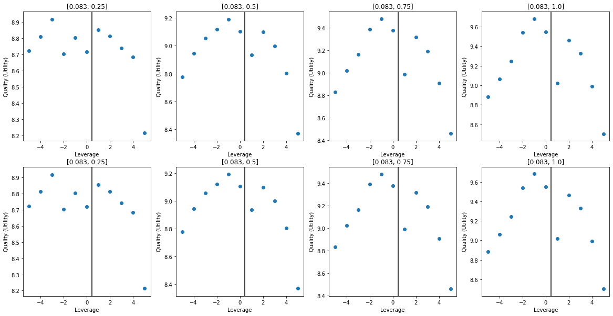
Trial VI
# DQN Hyperparameters
"Learning Rate”. : 0.0008
"Epoch" : 1
"Network Size" : [21, 21, 21]
"Activation" : "Sigmoid"
"Alpha" : 0.0
"Batch Size" : 128
"Action Dim" : 11
"Retrain Frequency" : 1 # Episode(s)
"Gamma" : 0.9992
# Environment Settings
”Mu" : 0.06
"Sigma" : 0.35
"Risk Free" : 0.01
"Max/Min Leverage" : +-5
"Time Horizon" : 1/12
"Time Step" : 1/12
"Risk Aversion" : 0.9
"Number Eps" : int(1e4)
Notes:
Much greater sensitivity to wealth, which is highly desirable.
Strangely there is a sharp decline in quality which corresponds perfectly to the optimal action.

Slide 11
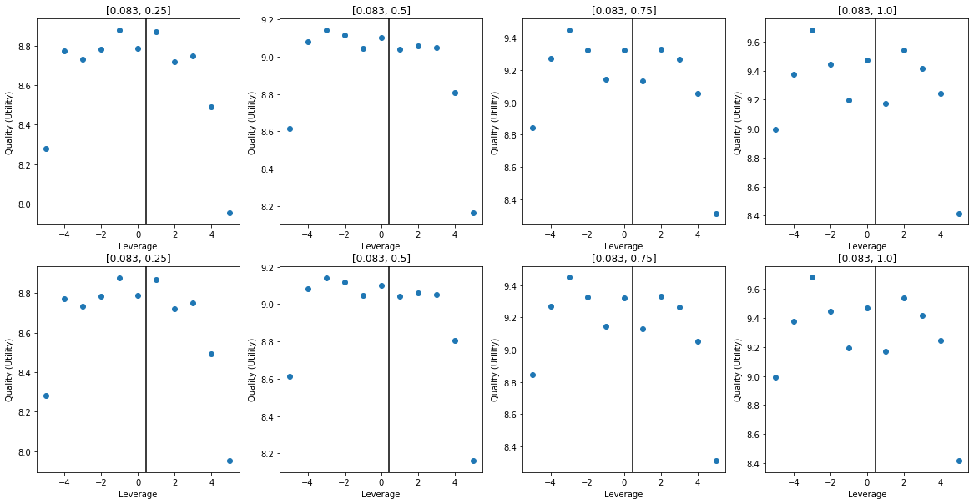
Trial VII
# DQN Hyperparameters
"Learning Rate”. : 0.0004
"Epoch" : 1
"Network Size" : [11]
"Activation" : "Sigmoid"
"Alpha" : 0.0
"Batch Size" : 32
"Action Dim" : 11
"Retrain Frequency" : 1 # Episode(s)
"Gamma" : 0.9992
# Environment Settings
”Mu" : 0.06
"Sigma" : 0.35
"Risk Free" : 0.01
"Max/Min Leverage" : +-5
"Time Horizon" : 1/12
"Time Step" : 1/12
"Risk Aversion" : 0.9
"Number Eps" : int(1e4)
Notes:
As greater appreciation of the wealth dependency as any model. Shows that a large network is not required.
Prediction is still noisy, L2 does not seem to help in this case.

Slide 12
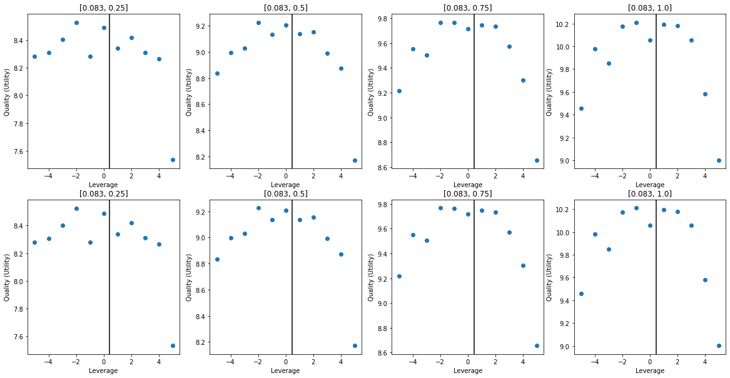
Trial VIII
# DQN Hyperparameters
"Learning Rate”. : 0.0008
"Epoch" : 10
"Network Size" : [11]
"Activation" : "Sigmoid"
"Alpha" : 0.005
"Batch Size" : 32
"Action Dim" : 11
"Retrain Frequency" : 1 # Episode(s)
"Gamma" : 0.9992
"Epsilon Range" : [1, 0.5]
# Environment Settings
”Mu" : 0.06
"Sigma" : 0.35
"Risk Free" : 0.01
"Max/Min Leverage" : +-5
"Time Horizon" : 1/12
"Time Step" : 1/12
"Risk Aversion" : 0.9
"Number Eps" : int(1e4)
Notes:
Further fine tuning of the small model, produces decently smooth curve with true representation of the dependency of utility on wealth.
This model is now ready for multi-step Merton.

Slide 13
DQN Performance
Multi Step, Single Asset Merton

Slide 14
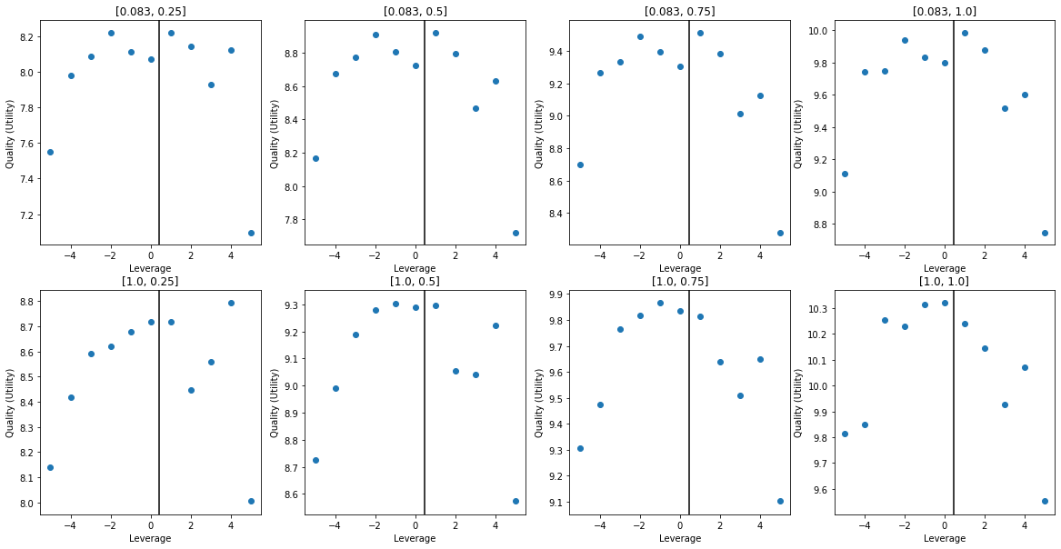
Trial I
# DQN Hyperparameters
"Learning Rate”. : 0.0008
"Epoch" : 10
"Network Size" : [32]
"Activation" : "Sigmoid"
"Alpha" : 0.0
"Batch Size" : 32
"Action Dim" : 11
"Retrain Frequency" : 1 # Episode(s)
"Gamma" : 0.9992
"Epsilon Range" : [1, 0.5]
# Environment Settings
”Mu" : 0.06
"Sigma" : 0.35
"Risk Free" : 0.01
"Max/Min Leverage" : +-5
"Time Horizon" : 1
"Time Step" : 1/12
"Risk Aversion" : 0.9
"Number Eps" : int(1e4)
Notes:
Acceptable starting settings, the affect of wealth has been appreciated, as well as the time value of wealth (The utility of $x is higher with one year till termination than 1 month till termination)
The results are still noisy.

Slide 15
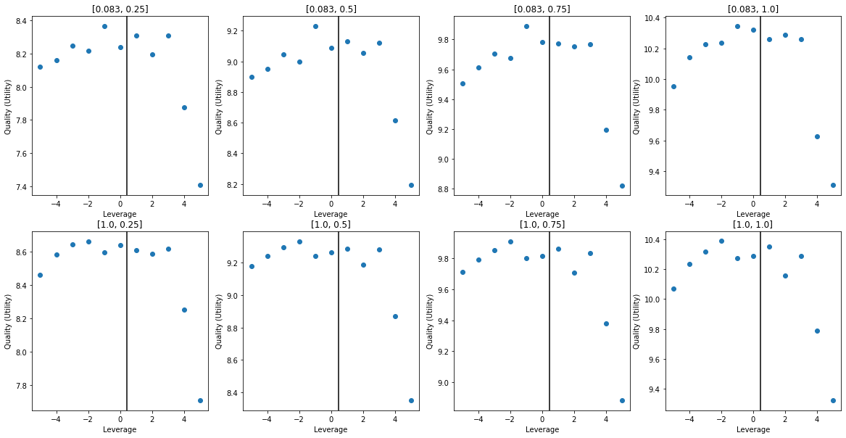
Trial II
# DQN Hyperparameters
"Learning Rate”. : 0.0008
"Epoch" : 10
"Network Size" : [32]
"Activation" : "Sigmoid"
"Alpha" : 0.0
"Batch Size" : 32
"Action Dim" : 11
"Retrain Frequency" : 1 # Episode(s)
"Gamma" : 0.9992
"Epsilon Range" : [1, 0.5]
# Environment Settings
”Mu" : 0.06
"Sigma" : 0.35
"Risk Free" : 0.01
"Max/Min Leverage" : +-5
"Time Horizon" : 1
"Time Step" : 1/12
"Risk Aversion" : 0.9
"Number Eps" : int(4e4)
Notes:
Increasing the number of episodes has had the benefit of smoothing curve, however the relationship between time and utility has been lost, which is not ideal.
Potentially suggest the network is too small, as it if being forced to predict a mean rather than the true relationship.

Slide 16
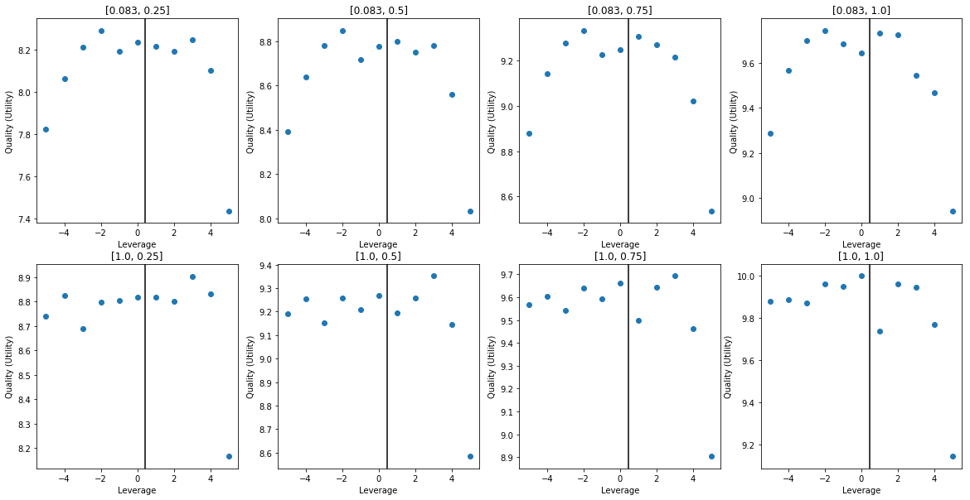
Trial III
# DQN Hyperparameters
"Learning Rate”. : 0.001
"Epoch" : 10
"Network Size" : [32]
"Activation" : "Sigmoid"
"Alpha" : 0.005
"Batch Size" : 32
"Action Dim" : 11
"Retrain Frequency" : 1 # Episode(s)
"Gamma" : 0.9992
"Epsilon Range" : [1, 0.5]
# Environment Settings
”Mu" : 0.06
"Sigma" : 0.35
"Risk Free" : 0.01
"Max/Min Leverage" : +-5
"Time Horizon" : 1
"Time Step" : 1/12
"Risk Aversion" : 0.9
"Number Eps" : int(1e4)
Notes:
Poor relationship between action and utility with 1 year until expiry.
Suggests either regularization is preventing the relationship from being realized as it to too weak, or the learning rate it too high.

Slide 17
Trial IV
# DQN Hyperparameters
"Learning Rate”. : 0.00075
"Epoch" : 10
"Network Size" : [32, 16]
"Activation" : "Sigmoid"
"Alpha" : 0.0
"Batch Size" : 32
"Action Dim" : 11
"Retrain Frequency" : 1 # Episode(s)
"Gamma" : 0.9992
"Epsilon Range" : [1, 0.5]
# Environment Settings
”Mu" : 0.06
"Sigma" : 0.35
"Risk Free" : 0.01
"Max/Min Leverage" : +-5
"Time Horizon" : 1
"Time Step" : 1/12
"Risk Aversion" : 0.9
"Number Eps" : int(1e4)
Notes:
Poor relationship between action and utility with 1 year until expiry.
Suggests either regularization is preventing the relationship from being realized as it to too weak, or the learning rate it too high.

Slide 18
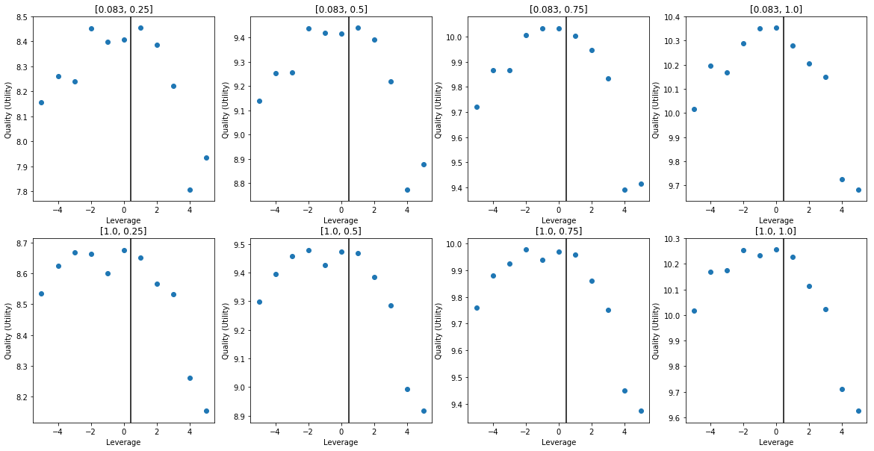
Trial V
# DQN Hyperparameters
"Learning Rate”. : 0.075
"Epoch" : 5
"Network Size" : [32, 16]
"Activation" : "Sigmoid"
"Alpha" : 0.005
"Batch Size" : 1024
"Action Dim" : 11
"Retrain Frequency" : 8 # Episode(s)
"Gamma" : 0.9992
"Epsilon Range" : [1, 0.5]
# Environment Settings
”Mu" : 0.06
"Sigma" : 0.35
"Risk Free" : 0.01
"Max/Min Leverage" : +-5
"Time Horizon" : 1
"Time Step" : 1/12
"Risk Aversion" : 0.9
"Number Eps" : int(1e4)
Notes:
The larger neural network requires more data to be present per refit, as it has hundreds of parameters and really should not be operated with batch size less than the number parameters. As the batch size is increases so must the learning rate as observations will average out against one another. The retrain frequency was increased and the Epoch was decreased to reduce the runtime of the algorithm with the new batch size.

Slide 19
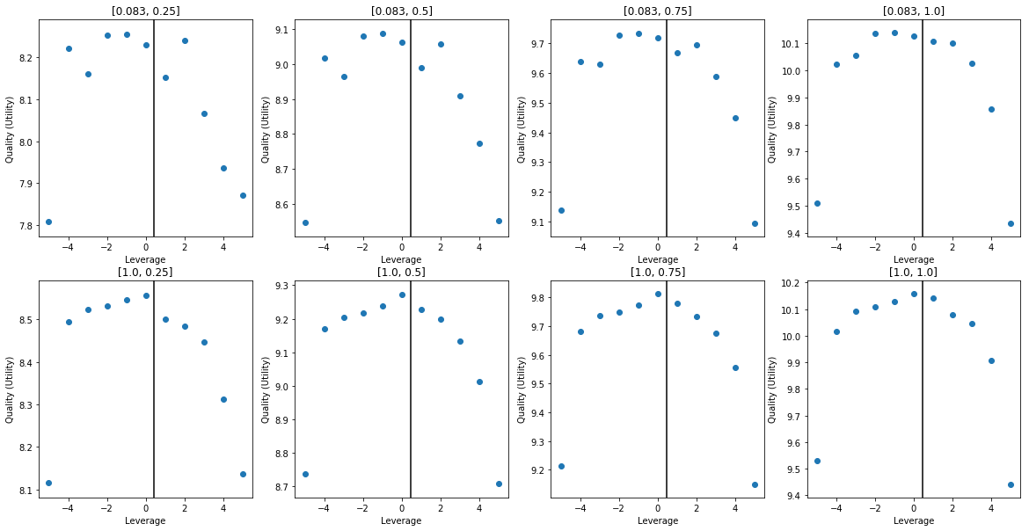
Trial VI
# DQN Hyperparameters
"Learning Rate”. : 0.075
"Epoch" : 5
"Network Size" : [64, 16]
"Activation" : "Sigmoid"
"Alpha" : 0.005
"Batch Size" : 2048
"Action Dim" : 11
"Retrain Frequency" : 16 # Episode(s)
"Gamma" : 0.9992
"Epsilon Range" : [1, 0.5]
# Environment Settings
”Mu" : 0.06
"Sigma" : 0.35
"Risk Free" : 0.01
"Max/Min Leverage" : +-5
"Time Horizon" : 1
"Time Step" : 1/12
"Risk Aversion" : 0.9
"Number Eps" : int(1e4)
Notes:
Another run with a larger network, performance has continued to improve.
This network has 1328 weights and 91 biases.

Slide 20
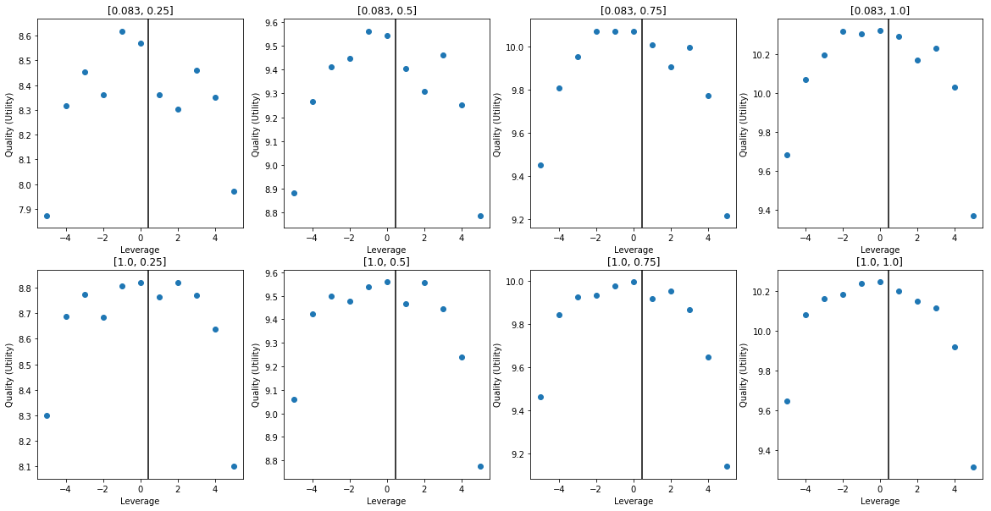
Trial VII
# DQN Hyperparameters
"Learning Rate”. : 0.075
"Epoch" : 5
"Network Size" : [128, 16]
"Activation" : "Sigmoid"
"Alpha" : 0.005
"Batch Size" : 3072
"Action Dim" : 11
"Retrain Frequency" : 16 # Episode(s)
"Gamma" : 0.9992
"Epsilon Range" : [1, 0.5]
# Environment Settings
”Mu" : 0.06
"Sigma" : 0.35
"Risk Free" : 0.01
"Max/Min Leverage" : +-5
"Time Horizon" : 1
"Time Step" : 1/12
"Risk Aversion" : 0.9
"Number Eps" : int(1e4)
Notes:
Another network with even larger initial layer, to test performance vs the optimal solution found in previous investigations.
This network has 2480 weights and 155 biases.

Slide 21
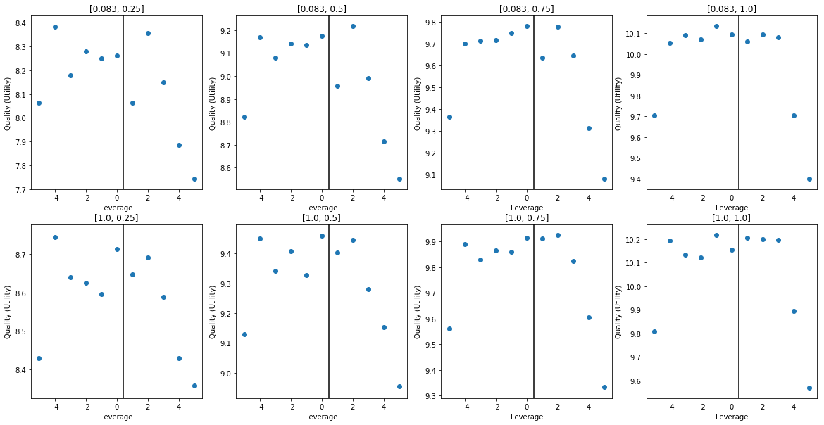
Trial VIII
# DQN Hyperparameters
"Learning Rate”. : 0.075
"Epoch" : 5
"Network Size" : [32, 32]
"Activation" : "Sigmoid"
"Alpha" : 0.005
"Batch Size" : 2048
"Action Dim" : 11
"Retrain Frequency" : 16 # Episode(s)
"Gamma" : 0.9992
"Epsilon Range" : [1, 0.5]
# Environment Settings
”Mu" : 0.06
"Sigma" : 0.35
"Risk Free" : 0.01
"Max/Min Leverage" : +-5
"Time Horizon" : 1
"Time Step" : 1/12
"Risk Aversion" : 0.9
"Number Eps" : int(1e4)
Notes:
This network has 1440 weights and 75 biases.
Interestingly performance is much worse than the ‘triangular’ network with the same degrees of freedom.

Slide 22
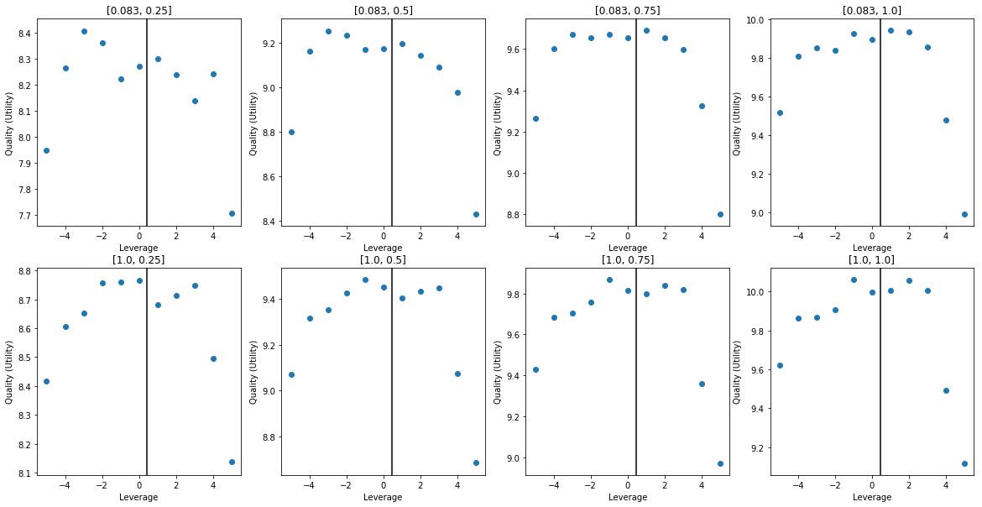
Trial IX
# DQN Hyperparameters
"Learning Rate”. : 0.075
"Epoch" : 5
"Network Size" : [64, 8]
"Activation" : "Sigmoid"
"Alpha" : 0.005
"Batch Size" : 2048
"Action Dim" : 11
"Retrain Frequency" : 16 # Episode(s)
"Gamma" : 0.9992
"Epsilon Range" : [1, 0.5]
# Environment Settings
”Mu" : 0.06
"Sigma" : 0.35
"Risk Free" : 0.01
"Max/Min Leverage" : +-5
"Time Horizon" : 1
"Time Step" : 1/12
"Risk Aversion" : 0.9
"Number Eps" : int(1e4)
Notes:
This network has 1440 weights and 75 biases.
Interestingly performance is much worse than the ‘triangular’ network with the same degrees of freedom.

Slide 23
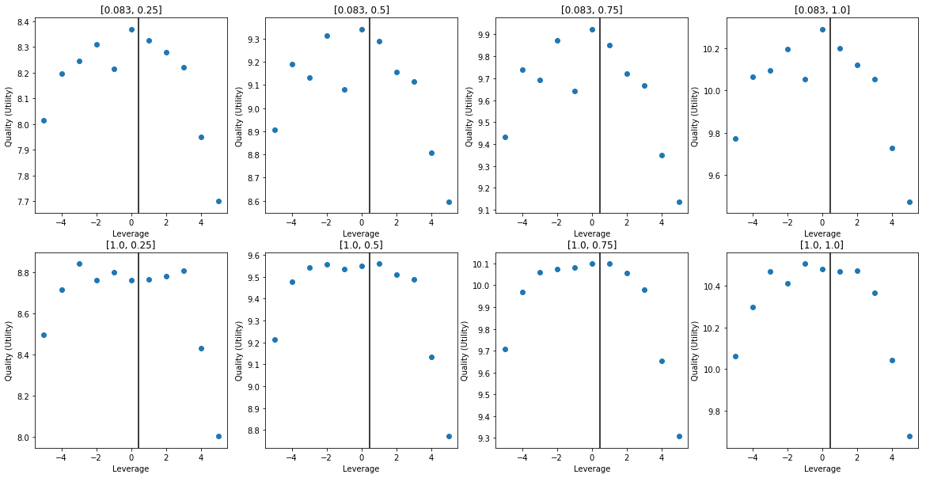
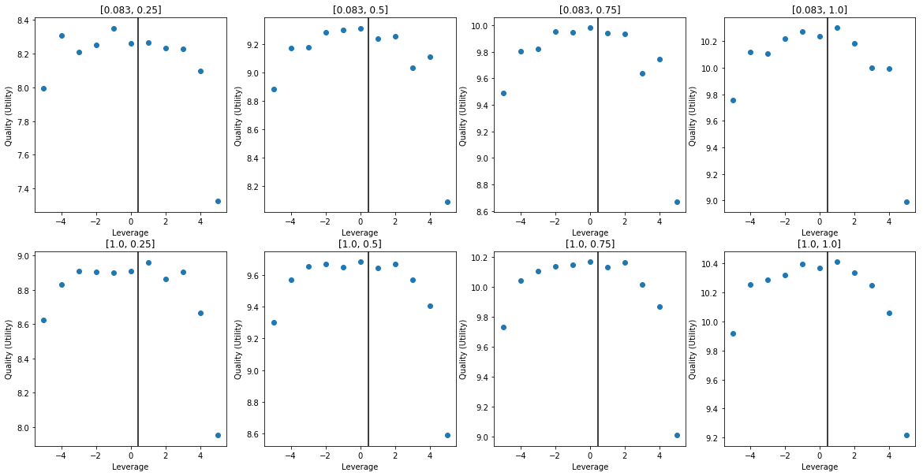
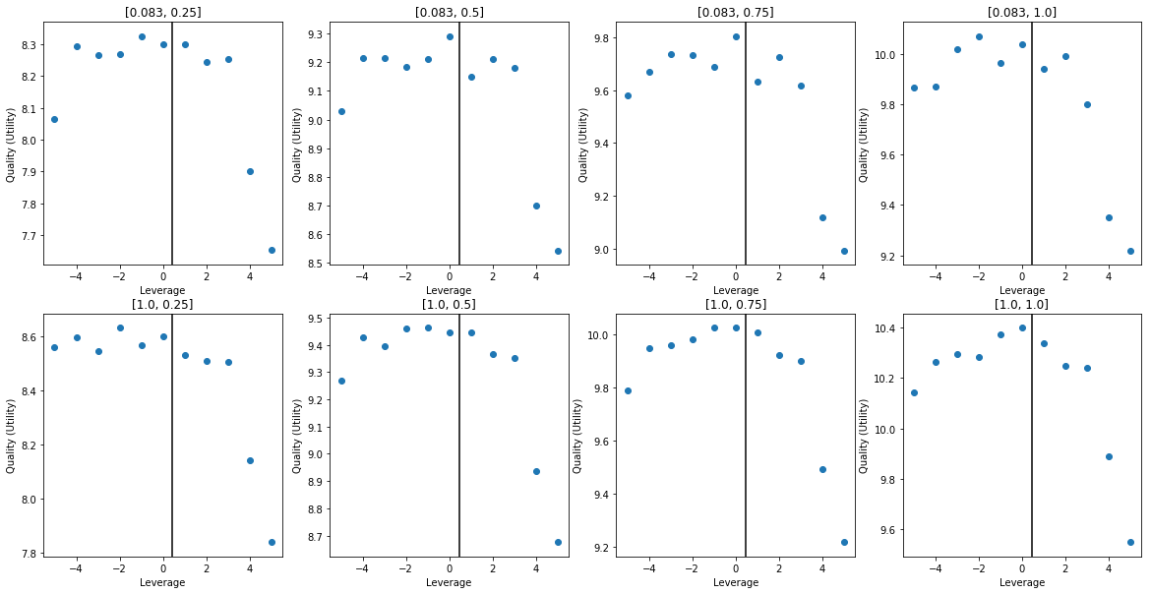
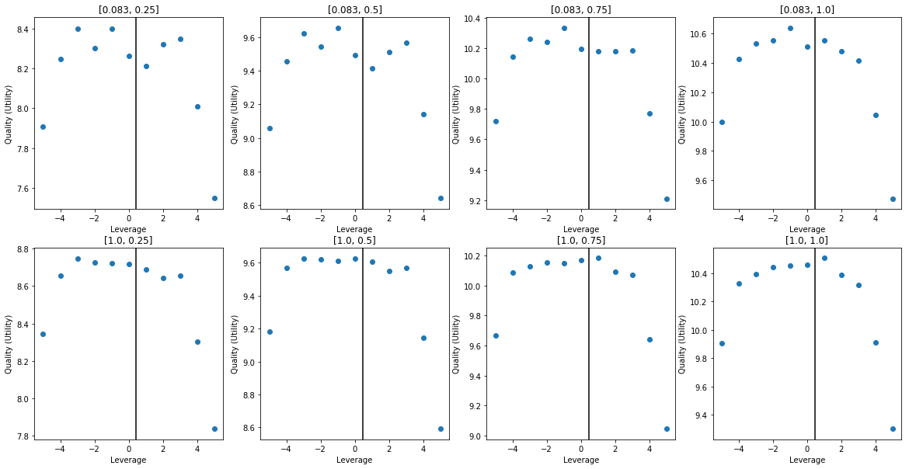
Trial X
# DQN Hyperparameters
"Learning Rate”. : 0.075
"Epoch" : 5
"Network Size" : [64, 16]
"Activation" : "Sigmoid"
"Alpha" : 0.005
"Batch Size" : 2048
"Action Dim" : 11
"Retrain Frequency" : 16 # Episode(s)
"Gamma" : 0.9992
"Epsilon Range" : [1, 0.1]
# Environment Settings
”Mu" : 0.06
"Sigma" : 0.35
"Risk Free" : 0.01
"Max/Min Leverage" : +-5
"Time Horizon" : 1
"Time Step" : 1/12
"Risk Aversion" : 0.9
"Number Eps" : int(2e4)
Notes:
A continuous problem throughout has been the repeatability of results; a small amount of variance is expected from instance to instance, however previously this has been excessive.

Slide 24
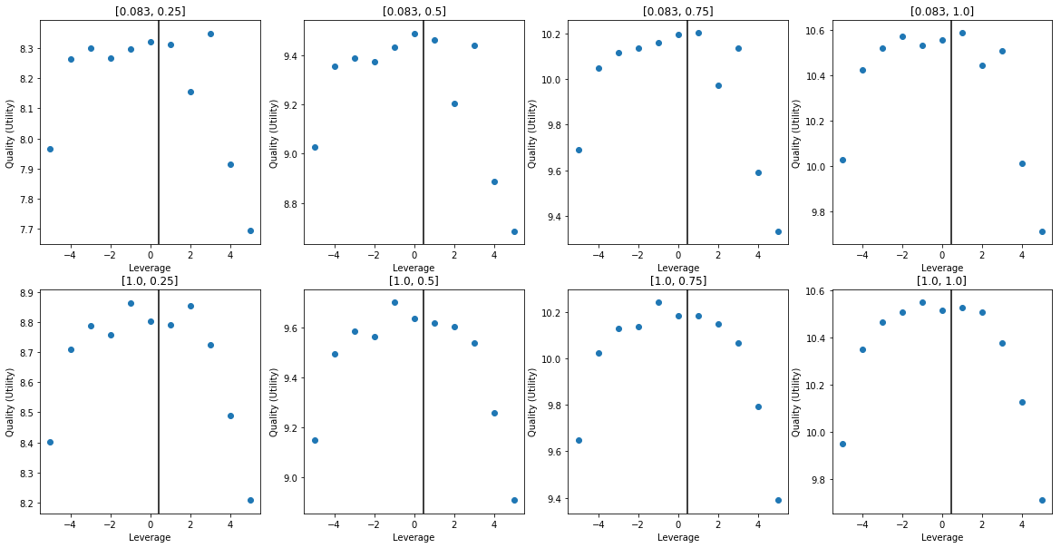
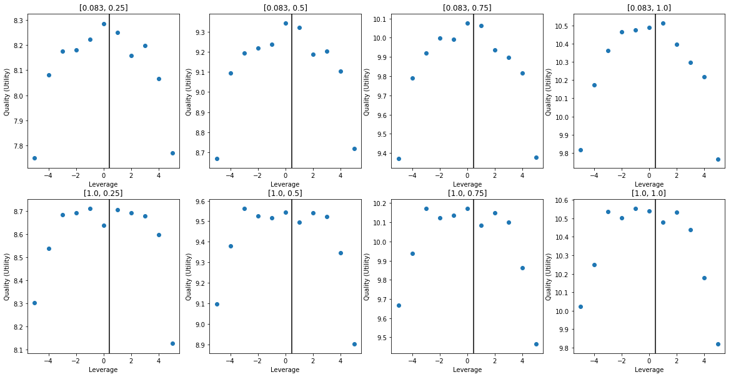
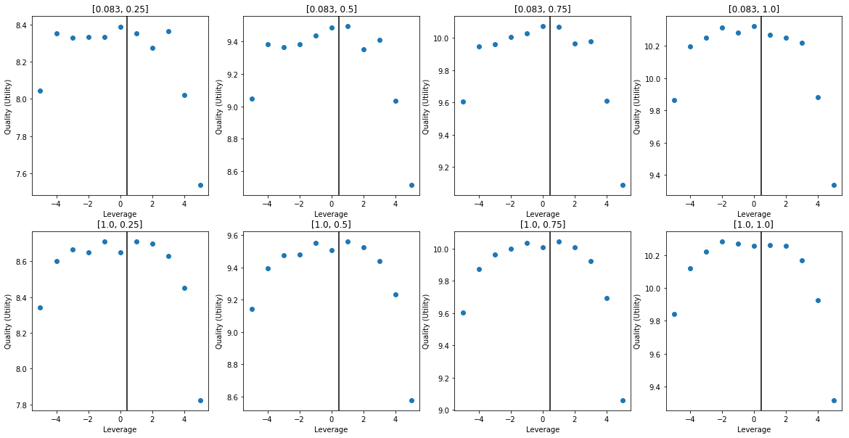
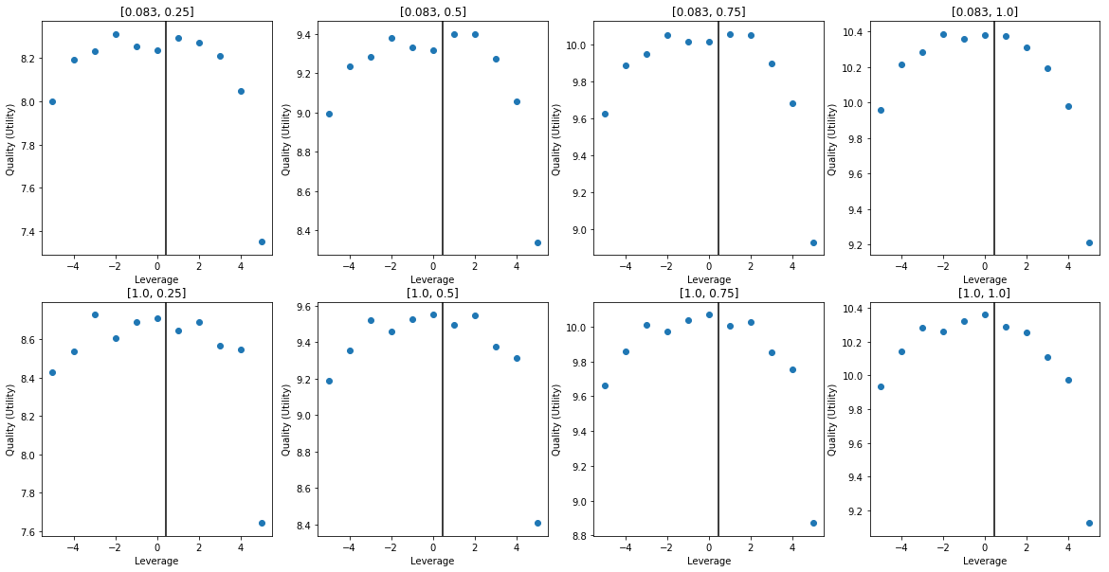
Trial XI
# DQN Hyperparameters
"Learning Rate”. : 0.075
"Epoch" : 5
"Network Size" : [32, 16]
"Activation" : "Sigmoid"
"Alpha" : 0.005
"Batch Size" : 2048
"Action Dim" : 11
"Retrain Frequency" : 16 # Episode(s)
"Gamma" : 0.9992
"Epsilon Range" : [1, 0.1]
# Environment Settings
”Mu" : 0.06
"Sigma" : 0.35
"Risk Free" : 0.01
"Max/Min Leverage" : +-5
"Time Horizon" : 1
"Time Step" : 1/12
"Risk Aversion" : 0.9
"Number Eps" : int(2e4)
Notes:

Slide 25
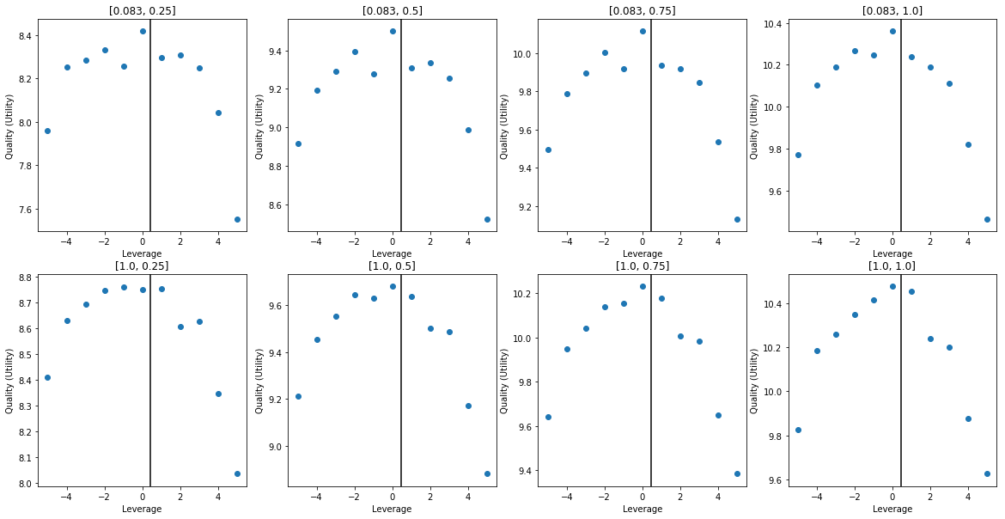
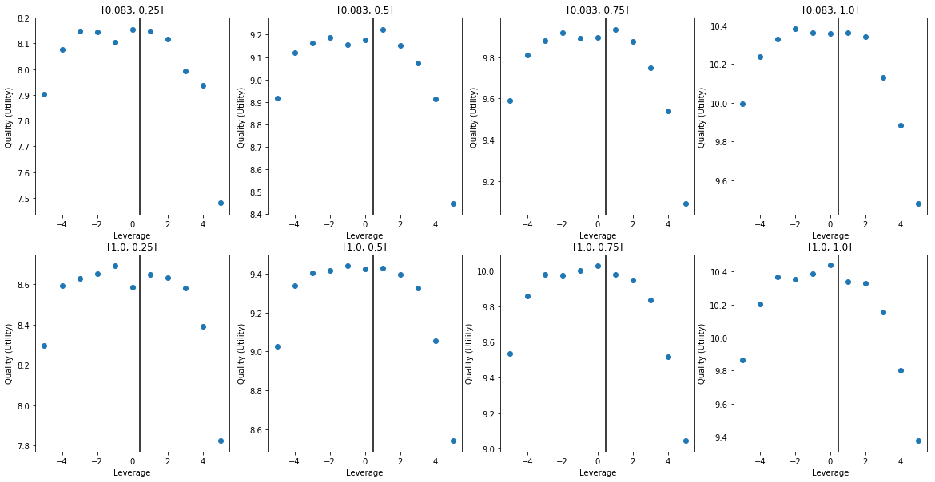
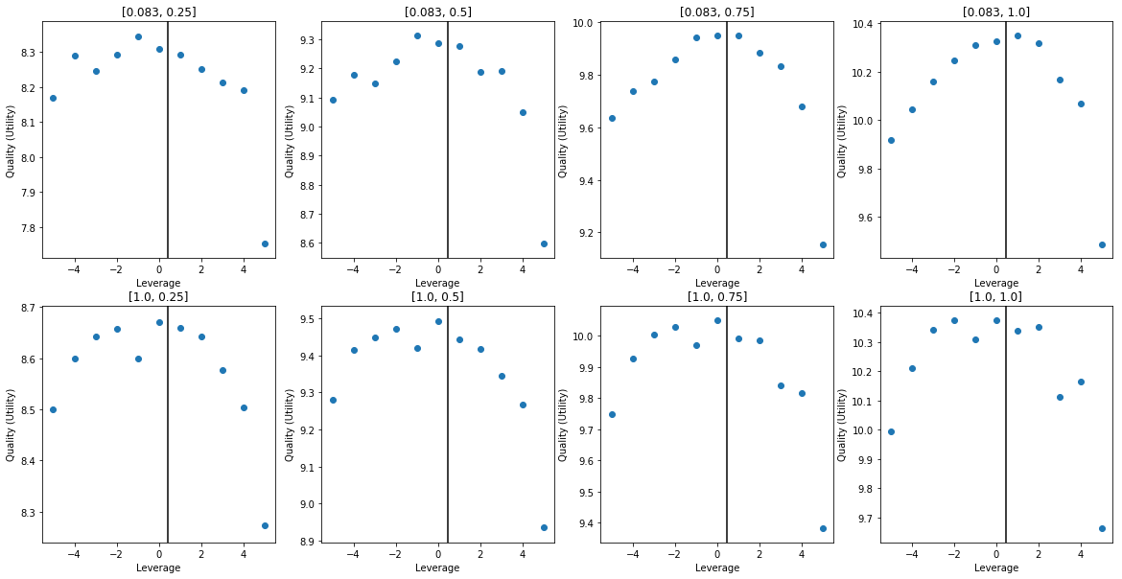
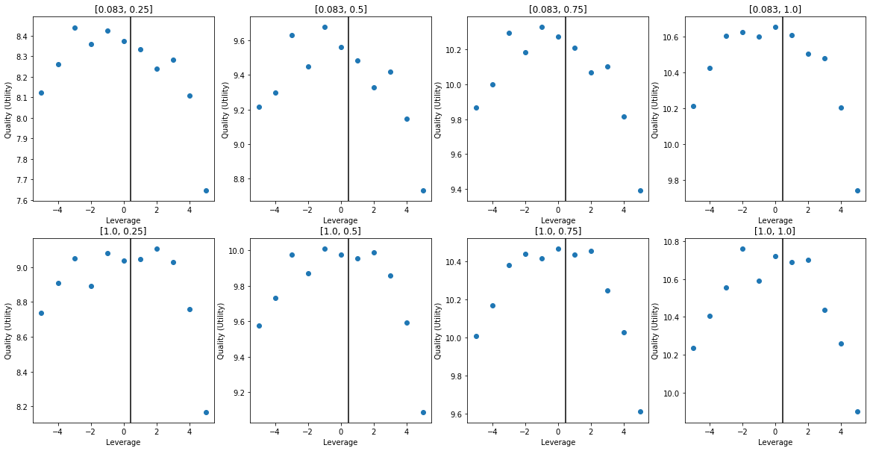
Trial XII
# DQN Hyperparameters
"Learning Rate”. : 0.075
"Epoch" : 5
"Network Size" : [32, 16]
"Activation" : "Sigmoid"
"Alpha" : 0.01
"Batch Size" : 2048
"Action Dim" : 11
"Retrain Frequency" : 16 # Episode(s)
"Gamma" : 0.9992
"Epsilon Range" : [1, 0.1]
# Environment Settings
”Mu" : 0.06
"Sigma" : 0.35
"Risk Free" : 0.01
"Max/Min Leverage" : +-5
"Time Horizon" : 1
"Time Step" : 1/12
"Risk Aversion" : 0.9
"Number Eps" : int(2e4)
Notes:

